Slide 1
Data Analysis in Criminal Justice
Probability

Slide 2
Probability Definitions
Trial
Any operation that results in the collection of observations, whose outcomes cannot be predicted in advance with certainty(aka, experiment)
Outcome
Each distinct result of a trial
Sample Space
The set of all possible outcomes, denoted S

Slide 3
Probability Definitions (cont.)
Classic Examples – coins, cards, & dice
Trial: flip a coin, roll a die, draw a card
Outcome: heads, “2”, ace of spades
Sample space: {H, T}, {1,2,3,4,5,6}, {all 52 cards}

Slide 4

Probability Definitions (cont.)
Event
Any collection of outcomes, or any subset of S
“Success”: Event occurs
Complement of an event
The set of all possibilities of an event not occurring
“Failure”: Event does not occur
By definition, p(A) + p(A’) = 1

Slide 5
Examples of Events
Flip a coin: S = {H,T}
p(H) =
Roll a die: S = {1,2,3,4,5,6}
p(1) =
p(even) =
Draw a card: S = {all 52 cards}
p(jack of diamonds) =
p(ace) =

Slide 6
More on Events
The notion of the probability of an event deals with events over the long run, or over an infinite number of trials (theoretical)
Does not imply that if we flip a coin twice, we will always get “heads” on one trial and “tails” on the other.
Probability as a “limiting relative frequency”
In contrast to a proportion (or relative frequency) from a distribution of outcomes in a finite sample

Slide 7

Rules of Counting #1
Basic counting rule
# of total possible outcomes from “n” independent trials
k_{i} = # total outcomes from trial “i”

Slide 8
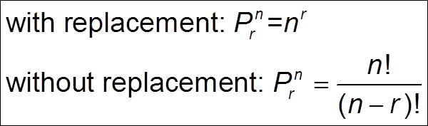
Rules of Counting #2
Permutation rule
# of possible ordered arrangements of “r” objects from a group of “n” objects
Order matters
Factorial notation: 3! = (3)(2)(1) = 6 and 0! = 1

Slide 9
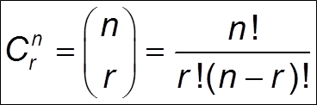
Rules of Counting #3
Combination rule
# of possible unordered arrangements of “r” objects from a group of “n” objects
Order does not matter

Slide 10
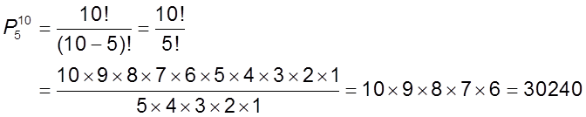
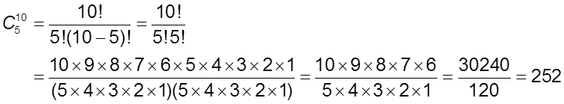
Counting by Hand
Permutations = P₅¹⁰
Combinations = C₅¹⁰

Slide 11
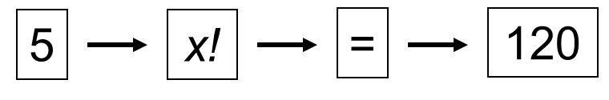
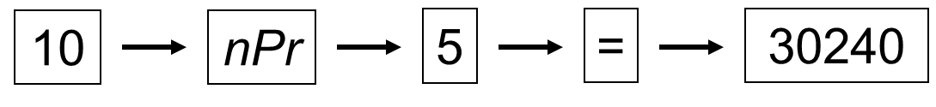
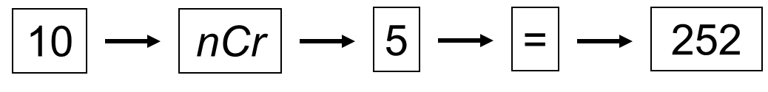
Counting on Your Calculator
Factorials = 5!
Permutations = P₅¹⁰
Combinations = C₅¹⁰

Slide 12
Counting Examples
License plate: 3 letters, 3 numbers
How many different sequences?
Combination lock: 36 numbers, 3 in combo
How many different sequences?
Poker: 5 cards in hand
How many different hands?
Notes:
\License Plate (with replacement)
= 26 * 26 * 26 * 10 * 10 * 10 = 17576000
Combination Lock (with replacement)
= 36 * 36 * 36 = 46656
Poker (without replacement)
= 52! / (52-5)! = 311875200

Slide 13
Counting Marbles
Bag with four colored marbles (R, O, G, B)
# ordered arrangements of all four?
# ordered arrangements of two at a time?
# unordered arrangements of all four?
# unordered arrangements of two at a time?
Notes:
4! = 24
2) 4! / (4-2)! = 12
3)

Slide 14

Rule of Probability #1
Bounding Rule
Probabilities are bounded by zero and one
Can’t have probabilities that are negative or greater than one.

Slide 15

Rule of Probability #2
Addition Rule
Probability of observing either of two events, or the “union” of two or more events
Addition rule for mutually exclusive events
Two events cannot occur at the same time, therefore, no joint probability

Slide 16


Rule of Probability #3
Multiplication Rule
Probability of observing two or more events simultaneously, or the “intersection” of two or more events (aka, joint probability)
Multiplication Rule for Independent Events
Probability of event B unaffected by occurrence of A (e.g., sampling with replacement)

Slide 17
Conditional Probabilities
The probability of one event occurring given that another event has occurred
What is the likelihood that someone will be incarcerated if they commit a violent offense?
What is the chance someone will be injured in a car crash given that they don’t wear a seat belt?
What is the probability that a person will be convicted as an adult if they are convicted as a juvenile?
What is the probability that someone will relapse into drug use conditional on participating in a program?

Slide 18

Coins, Dice, & Cards
$p\left(H ∪T\right)=$ $p\left(1 ∪6\right)=$
$p\left(HH ∪TT\right)=$ $p\left(1 ∪2 ∪3\right)=$
$p\left(H ∩T\right)=$ $p\left(1 ∩6\right)=$
$p\left(HH ∩TT\right)=$ $p\left(1 ∩2 ∩3\right)=$
$p\left(H ∩H ∩H ∩H ∩H\right)=$
$p\left(A∪K\right)=$
$p\left(A ∪ ◊\right)=$
With replacement: $p\left(A ∩A\right)=$
Without replacement: $p\left(A ∩A\right)=$

Slide 19
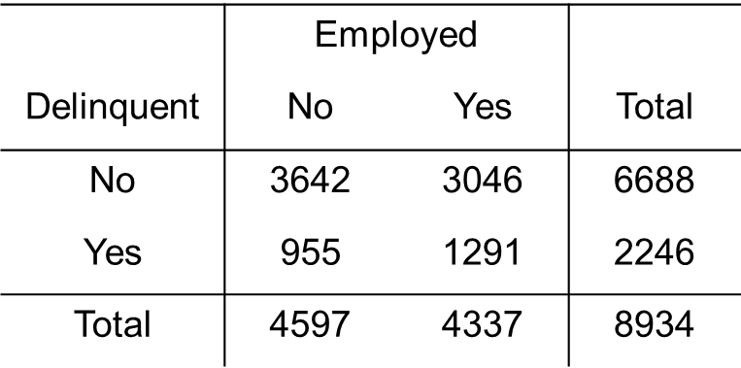
Contingency Tables
Joint distribution of two variables (‘cross-tab’)
Defined by # of categories (row x column)

Slide 20
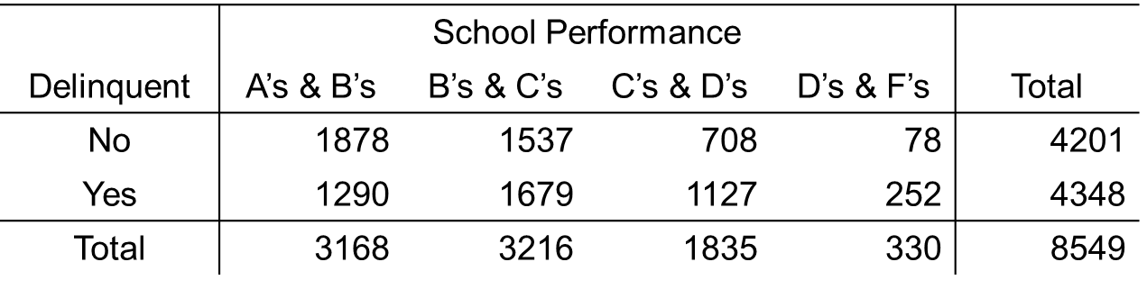
School Performance & Delinquency

Slide 21
Probability Theory & The Binomial Distribution
Probability distributions
Binomial probability distribution

Slide 22
Probability Distributions
Frequency distribution
Proportion = relative frequency you actually observe with data
Empirical
Probability distribution
Probability = limiting relative frequency you don’t actually observe but expect to observe over the long run
Theoretical

Slide 23
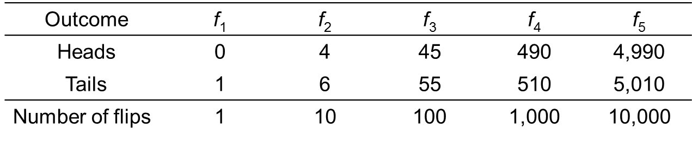
Probability Distributions (cont.)
Flipping a single coin
S = {H, T}
p(H) = .50
p(T) = .50

Slide 24
Probability Distributions (cont.)
The fact that we don’t actually observe a probability distribution does not make it less useful
We can know its properties without observing it (μ, σ ²)
This knowledge forms an essential link for hypothesis testing and statistical inference

Slide 25
Sex Composition
Families with 3 children
Each birth an independent “trial” w/2 outcomes
How many boy-girl sequences are possible?
Sex is independent across children
p(boy) = .52
p(girl) = .48

Slide 26
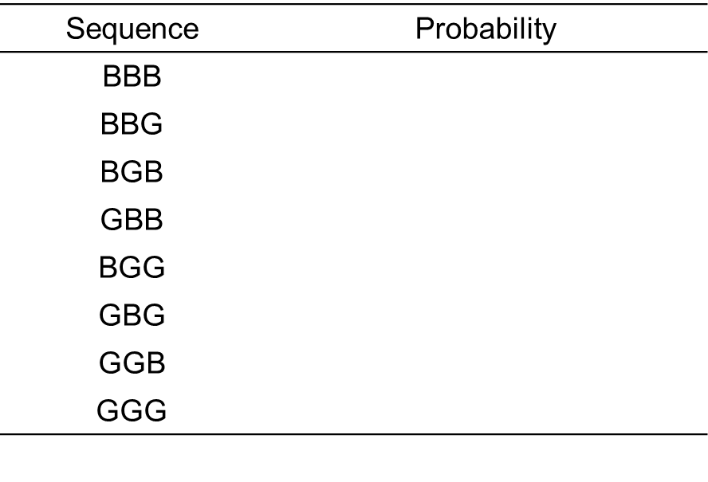
Sex Composition (cont.)
List all possible sequences & probabilities

Slide 27
Sex Composition (cont.)
p(1 girl) =
p(1 boy) =
p(2+ girls) =
p(2+ boys) =
Notice: I am not interested in the specific order of births

Slide 28
Binomial Distribution
Probability distribution for dichotomous outcomes
Events are labeled successes and failures
p(success) = p
p(failure) = q = 1 – p
n = independent trials
Probability of observing r successes in n trials
Specific sequence of successes and failures unimportant, only combinations

Slide 29
Binomial Distribution (cont.)
Combines multiplication rule with combination rule
Multiplication: probability of one specific sequence
Combination: # of possible sequences
Probability of having 1 girl out of 3 kids

Slide 30
Binomial Distribution (cont.)
Probability of observing r successes in n trials
Construct the full probability distribution
Success = birth of a girl
N = # of trials = 3
p = p(success) = .48
q = p(failure) = 1 - .48 = .52

Slide 31
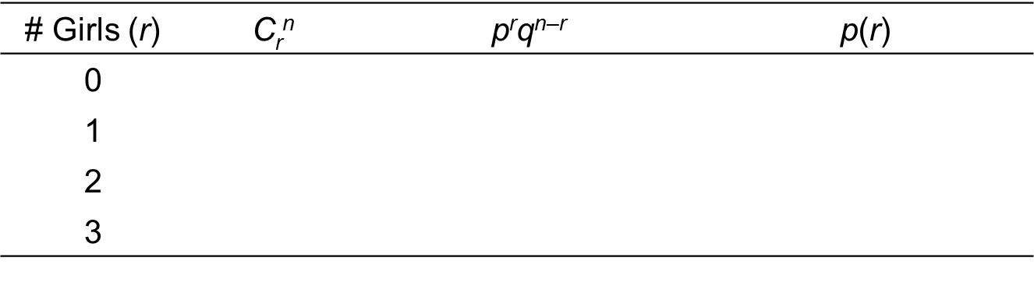
Sex Composition

Slide 32
Sex Composition Histogram
Mean = E(X) = μ = np =
Variance = V(X) = σ² = npq =

Slide 33
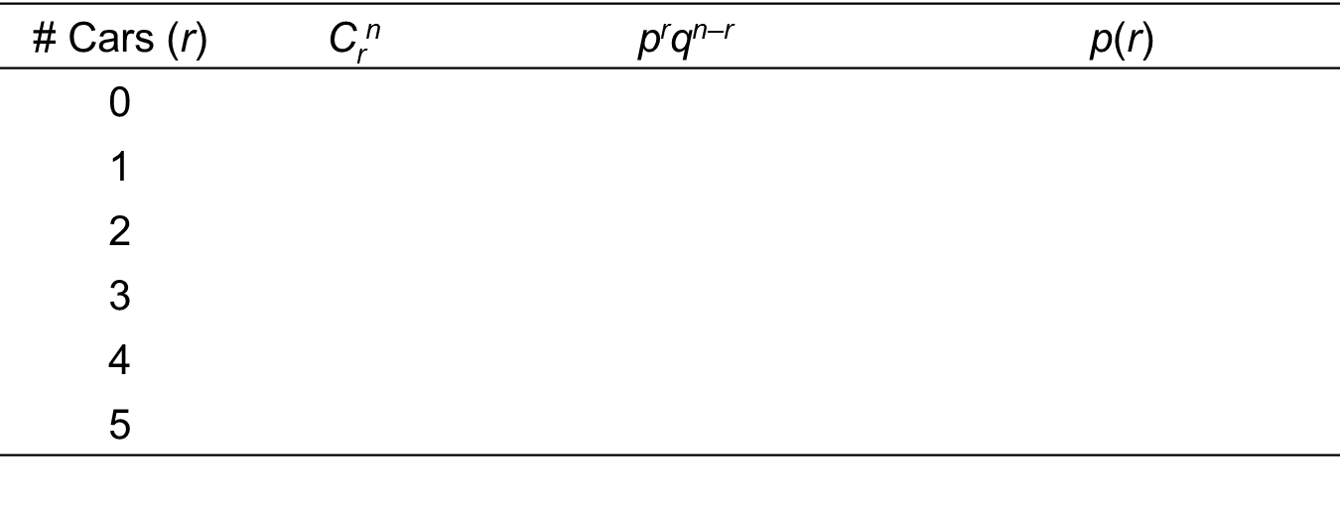
Running Red Lights
Success = run red light, n = 5 cars, p = .60
p(r = 4) =

Slide 34
Red Light Histogram
Mean =
Variance =

Slide 35
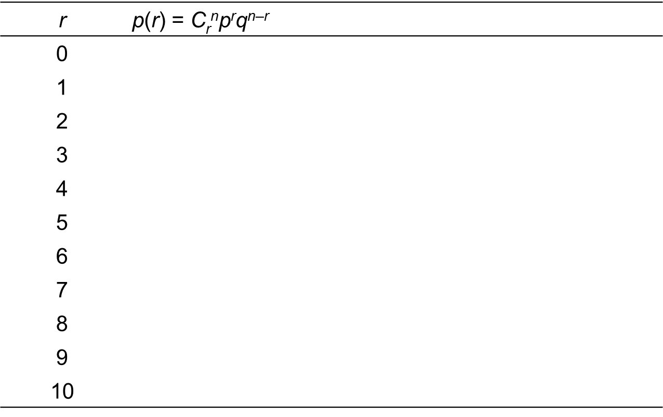
Running Red Lights (cont.)

Slide 36
Red Light Histogram
Mean =
Variance =

Slide 37

Cal Ripken
Suppose that a baseball player has only a 1/100 chance of missing any game due to illness or injury. What is the probability that he will play in 2,132 straight games?
p(r = 0) =
What is the probability that a player will miss at least one game due to illness or injury?
p(r $≥$ 1) =

Slide 38
Cal Ripken Histogram
Mean =
Variance =

Slide 39

Your Lying Roommate
Suppose your roommate takes a multiple choice quiz with 10 questions and 4 answers per question. Your roommate gets 8 correct and brags that she guessed on every question. What is the probability she would guess correctly on 8 or more questions?
p(r $≥$ 8) =

Slide 40
Lying Roommate Histogram
Mean =
Variance =

